Slide 1

DDMC 2024
Annapurna Chitta

Slide 2







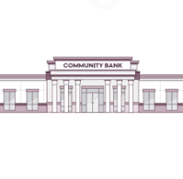
Agenda
Understanding Banks over years
Strategies for Optimization
History
Unbanked and
underbanked
Demographics
Institutional size
Impact Analysis
DDMC 2024
Notes:
Harrison

Slide 3
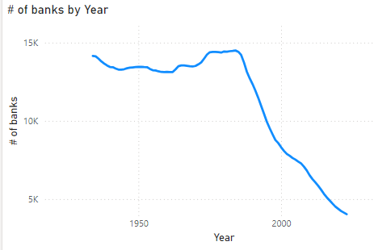
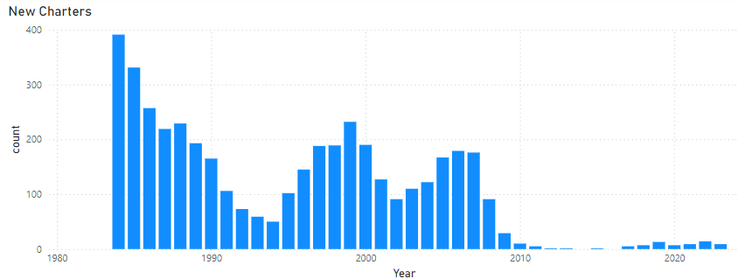
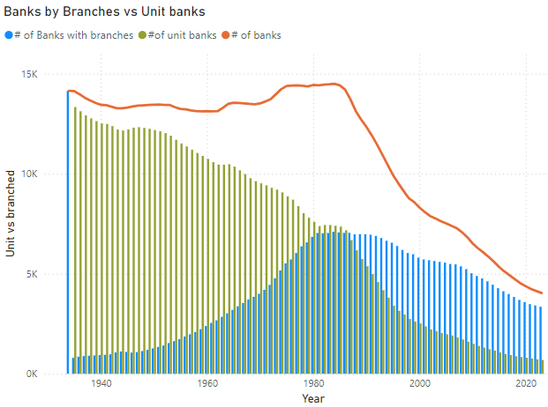
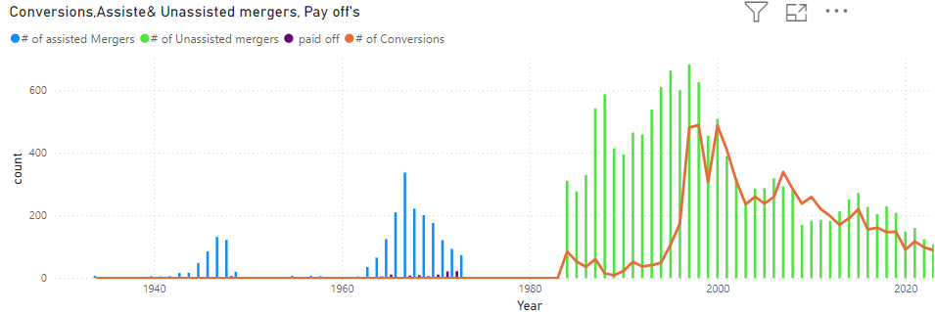
Banks over the years
DDMC 2024
Notes:
Harrison

Slide 4
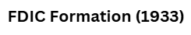

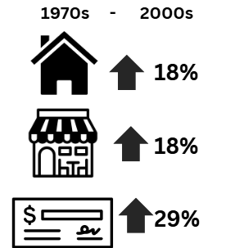
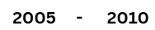
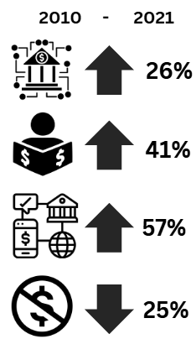
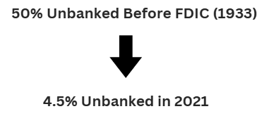


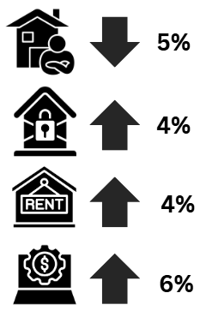

Impact - History
FDIC,
Glass – Steagall
Act
Community
Reinvestment
Act
Subprime Mortgage Crisis
Rise of FinTech
Deregulation of Banking
1934
1944
1939-45
1973
1970-1980
1997-98
2005
2010
2009-12
1933
1977
1980-1990
2007-2008
2010 to Present
FHA
Credit Union Growth
Bankruptcy Reform
Act
Dodd Frank Wall Street Reform
Banking - US
World Events
Bretton
Woods Conference
World War II
Oil Crisis
Asian Financial Crisis
Sovereign Debt Crisis
DDMC 2024
Notes:
Harrison

Slide 5
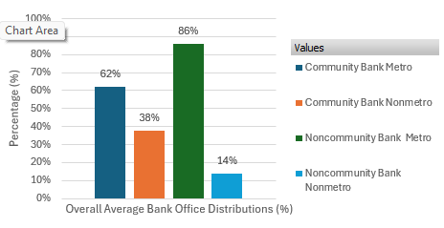


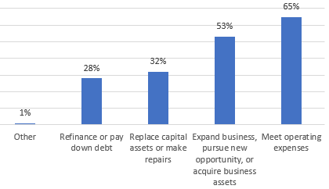
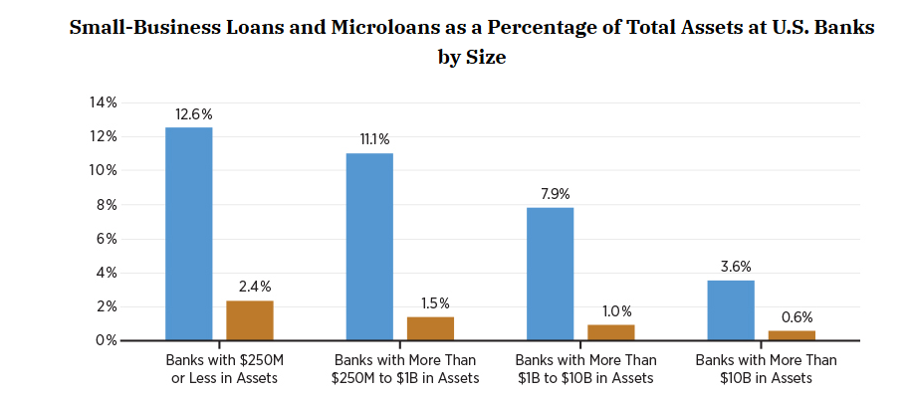

Impact – Community vs National
43%
10B
Average Bank Office Distribution by Type and Location (1987–2011)
USE SMALL BANKS
Community Bank Benefits
Community Economic Support
Relationship Lenders
Serving Local Communities
67%
Satisfaction Rating
81%
68%
Reasons Small Businesses Seek Financing
CRA Performance Score
82%
62%
DDMC 2024

Slide 6
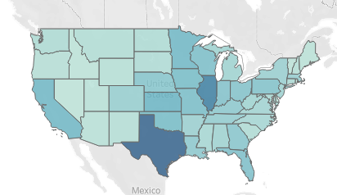
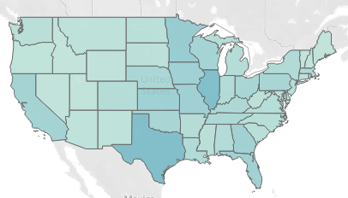
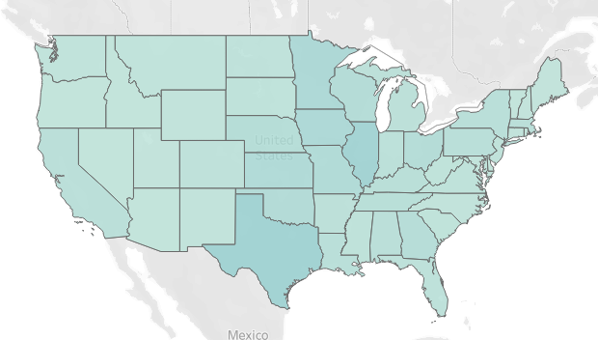
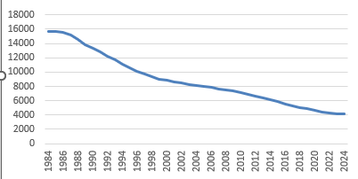
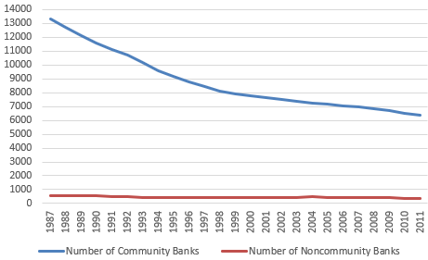
Impact – Community Banks Decline
Loss of Community Bank Offices 1984-2024
1984-1988
2004-2008
2024
Average Number of Community Banks 1984-2024
Number of Banking Organizations 1987-2011
DDMC 2024

Slide 7





Impact – Losing Community Banks
Small Business Lending ?
"The impact of these closures is severe, especially on rural and lower-income urban communities where few branches exist at all,” said Jesse Van Tol, CEO of Nation Community Reinvestment Coalition
"banking deserts"
"more likely to use high-fee payday loans and check-cashing services, which increases financial inequities"
Unbanked and Underbanked
7%
18%
DDMC 2024

Slide 8
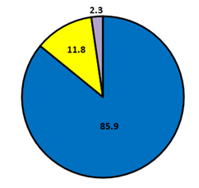
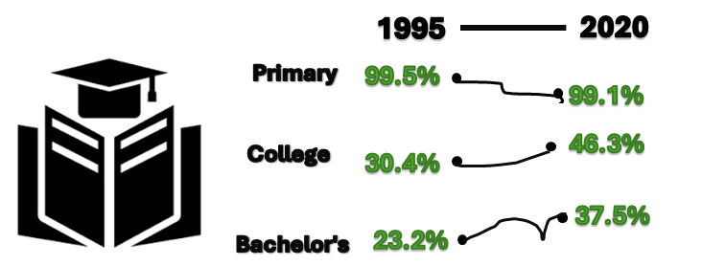
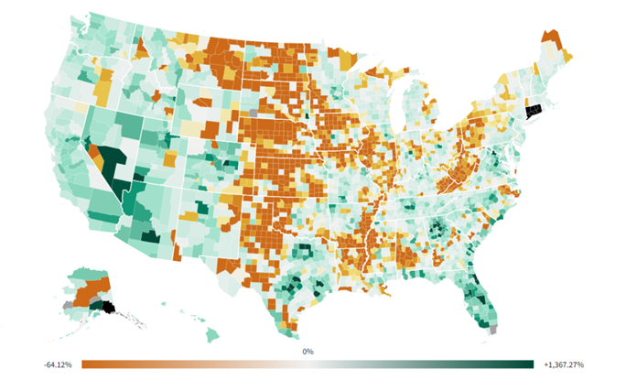

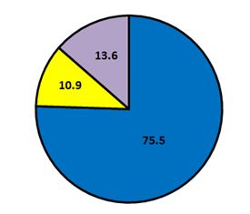
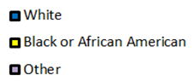

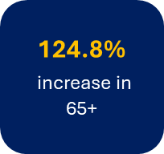
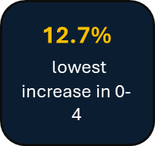
Impact - Demographics
1980
2022
Population
2022
Increase in ethnic diversity
1980
2020
Average annual growth rate of 0.9%
1980
227
Population (million)
330
1970
2018
Wealth of top 5%, increased by 4%
Shift towards aging population
29%
48%
Upper income
Middle income
Lower income
62%
43%
10%
9%
Wealth of lower tiers decreased by 20%
DDMC 2024

Slide 9
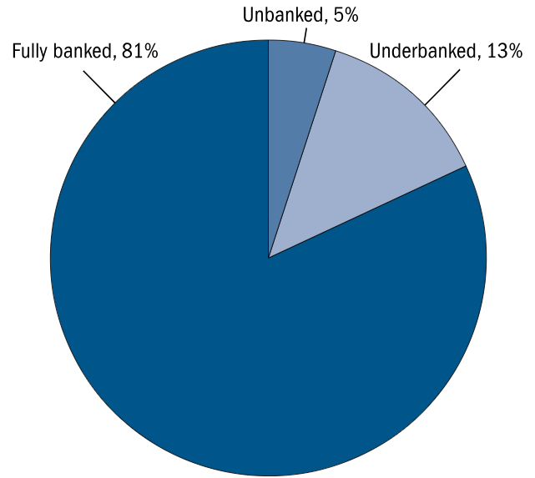
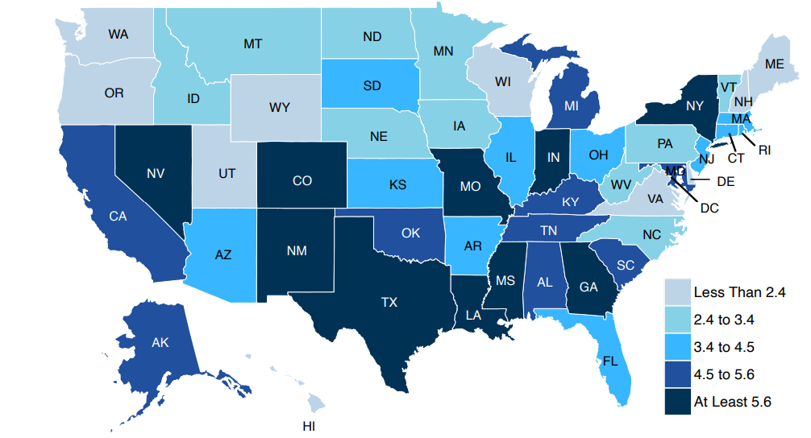



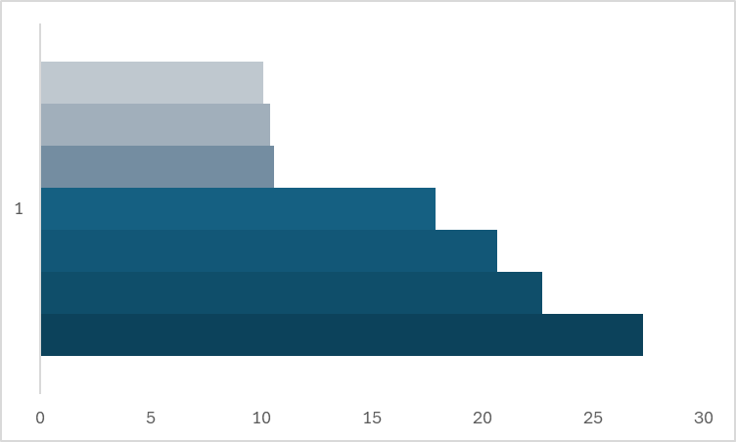


Impact – Unbanked & underbanked
Unpredictable account fees
34.1
Privacy
Fees to high
40.1
Location
Don’t have enough money
Past banking
14.1
Unbanked rate
33.0
Lacks needed
service/ products
1- 5 % reduction per year since 2013
Trust
5.3
Credit history
1983
2019
Age b/w 19-29
Increased rate
lower income,
adults with less education
Has reported health
Unbanked in poverty
unchanged for
4 decades
49.9 -1980’s 48.5 - 2010’s
Unmarried
49.6
27.3
Non-Citizen
In poverty
8.4
4.2
Age <19
Less than HS education
Affluent
Household in Poverty
All figures in percentages
Averages of 3 surveys – SIPP, SCF, FDIC
Courtesy: FDIC National Survey of Unbanked and Underbanked House & census Bureau report : Exploring Banking and Poverty Interactions over Time -2019
DDMC 2024

Slide 10




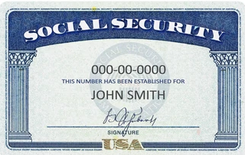




The Solution
Unified Payment Interface
Empower
Incentivize digital transactions
For unrepresented/ underprivileged
The trio for financial literacy
(Government agencies, banks and Community ), outreach and engagement
Dedicated financial programs and accounts-
Lesser stringent identification processes
Convenience
Reduced cash transactions
Reducing Fraud and laundering
Simplify with AI
Increased availability
Easier navigation through systems
DDMC 2024

